Slide 1
Physical computing from Scratch using scratchClient – Intermediate Control servos, LEDs and more from Scratch using RPi, Arduino, scratchClient
Hans de Jong & Gerhard Hepp
Workshop for the Pi And More conference

Slide 2
Part 1: Adding analog input

Slide 3
Changing the wiring on the board
When changing the wiring on the board
First pull out the power
the USB cable
the 9V supply

Slide 4
The electronics of a potentiometer
The potmeter is a resistor that will be connected between 5 V and 0 V.
Over the length of the resistor the voltage drops linearly.
E.g. in the middle it would be 2.5 Volt
So this is an analog signal. The value can be changed between 5 V and 0 V.
There is a 1 kOhm resistor in series for the reasons discussed earlier
+5 Volt
Consider what would happen if the 1 kOhm resistor were not there and the port would be used as output and potmeter positioned close to the 0 Volt side.
Then the Arduino would output 5 Volt, and the potmeter is directly leading it to the 0 Volt line → short circuit!
Likewise if the potentiometer is close to the 5 Volt side and the Arduino would output 0 Volt.
Arduino
1 kOhm
Potentiometer
Analog input
10 kOhm
Resistor
0 Volt

Slide 5
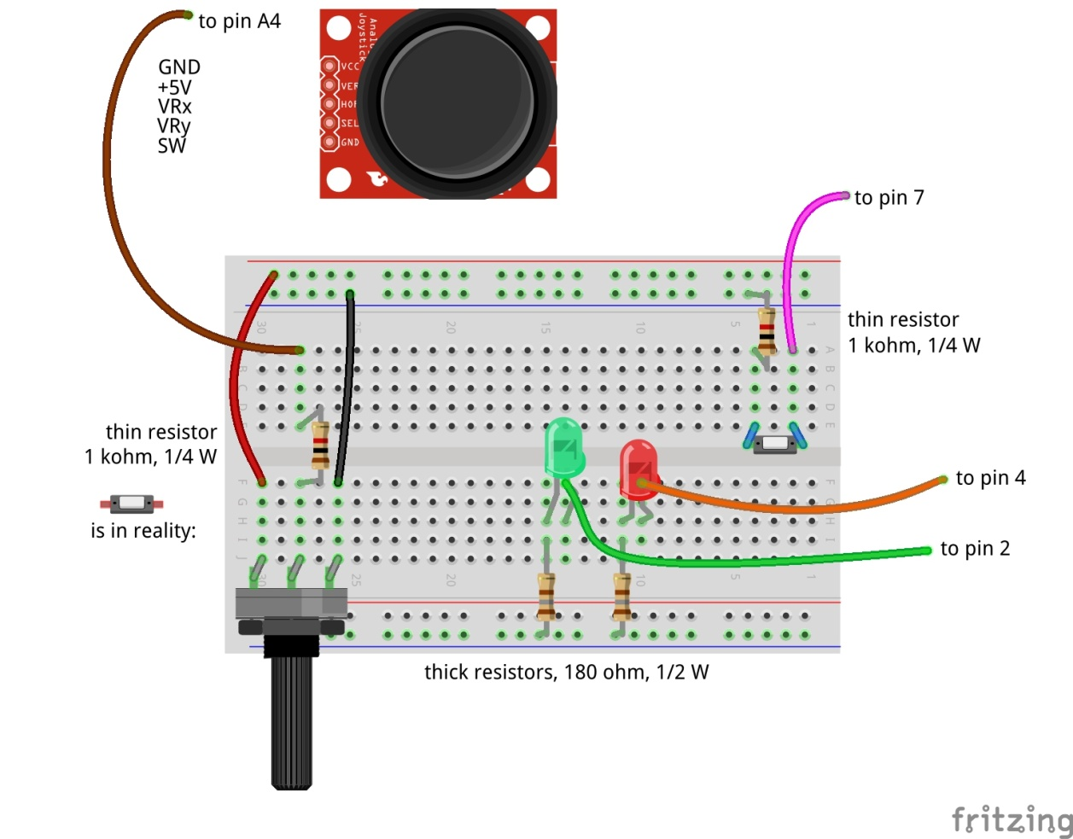
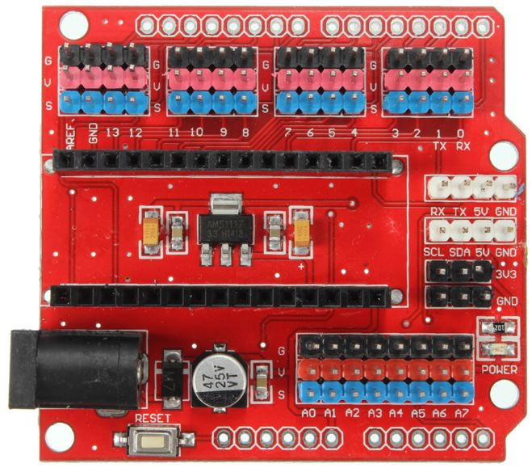

Adding analog input
Don’t forget: 9V and USB cable out before making changes!

Slide 6
Update the config file
Update the config file again (right click PiAndMoreConfig.scl on the desktop, scratchConfig Edit)
Define Potmeter on pin A4 (direction: in, function: analog)
Now that you are updating anyway, already define for the next steps:
Define Servo1 on pin 12 (direction: out, function: servo)
Define BigBlueLED on pin 5 (direction: out, function: PWM)
Define Buzzer on pin 11 (direction: out, function: PWM)
Don’t forget to save. Keep the config editor open.

Slide 7
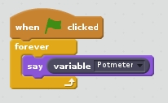
Test whether it works
Reconnect and repower the board
Stop and restart scratchClient by double clicking PiAndMoreConfig.scl on the desktop
Make this piece of program and run it
Turn the knob and see the values of Potmeter change
Between about 0 and about 1023
We will write some Scratch program to use it in the next step

Slide 8
Part 2: Pulse Width Modulation

Slide 9
Where we are …
We have seen:
Digital Input (the button) (in the beginners module)
Digital Output (the LEDs) (in the beginners module)
Analog Input (the potentiometer)
So what would be most logical next?
Analog Output? → but it does not exist!
However there is a good alternative: Pulse Width Modulation

Slide 10
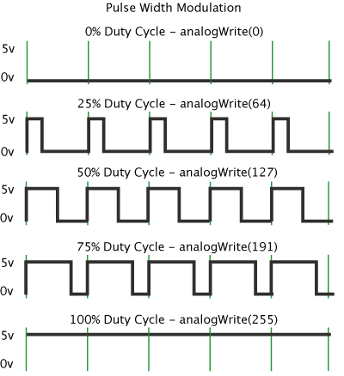
Pulse Width Modulation (PWM)
By modulating (changing) the pulse width, the amount of energy fed to e.g. the LED is changed, and hence the intensity with which you see it lighting.
Note that in practice the LED is blinking some 800 blinks / second.
However, no human eye can see more than 100 blinks / second.

Slide 11
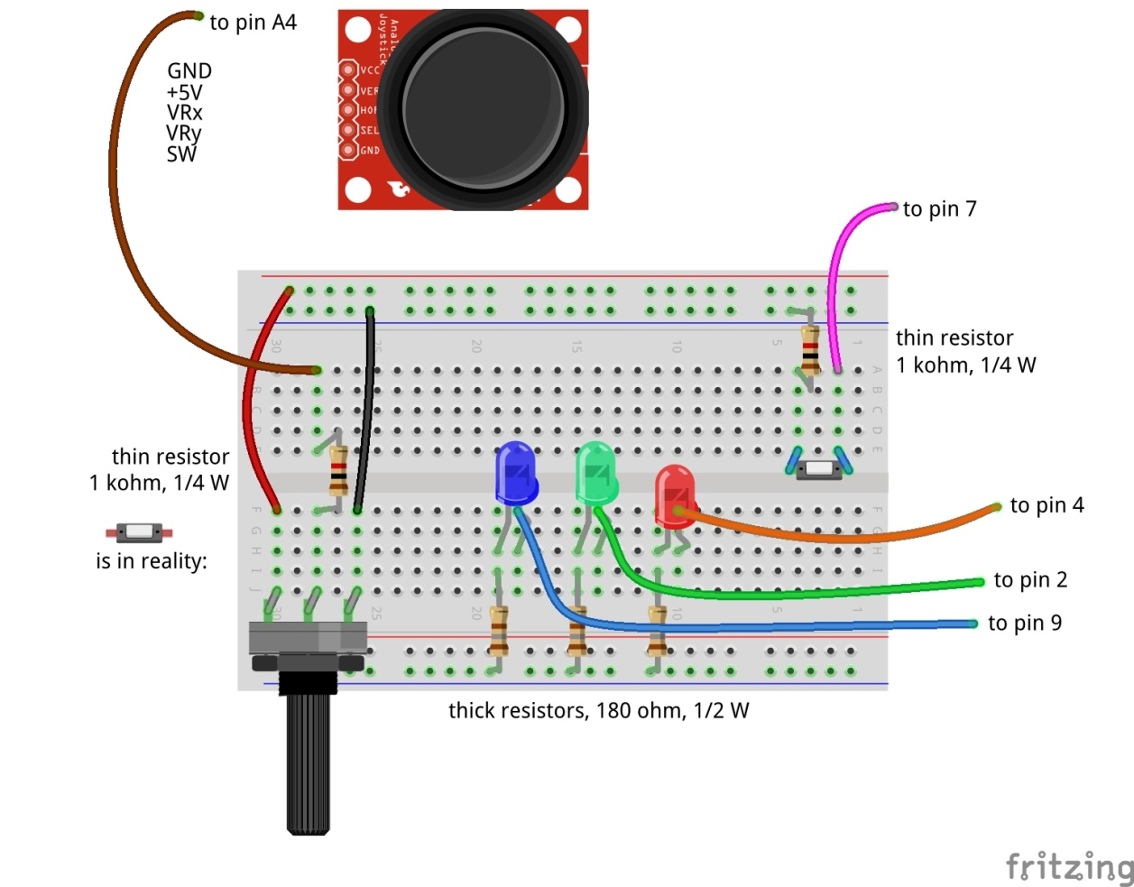
Dimming the BigBlueLED with PWM
to pin 5
Don’t forget: 9V and USB cable out before making changes!

Slide 12
Test
Reconnect USB and 9V adapter
You will see that scratchClient finds the board again
You already updated the config file in the previous step, so no need to restart scratchClient
Send BigBlueLED values between 0 and 255
Does the LED brightness change?

Slide 13
Connect Potmeter and Big Blue LED (via Scratch)
Make some code that takes the potentiometer reading (between 0 and 1023) and transforms it into the range 0 to 255 (so divide by 4) and set the value of BigBlueLED.
Try out whether turning the potmeter changes the light intensity.
Notice that when turning to the right, the intensity goes down.
You would expect it to go up …
How can you very simply change this by interchanging two wires?

Slide 14
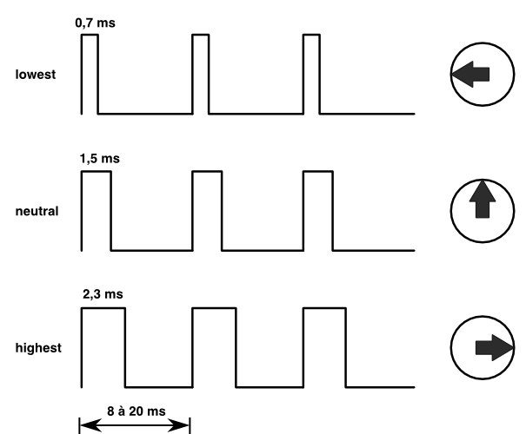
Controlling a servo with PWM
The position of the servo is changed by sending pulses of different width.
The servo looks at the pulsewidth and turns as desired.
The servo gets power separately.
With a servo, the pulse width modulation is not controlling the amount of energy fed to the servo
With a servo, pulse width modulation is rather a communication protocol.

Slide 15
Adding the servo to pin 12
to pin 5
Dark brown wire here
Don’t forget: 9V and USB cable out before making changes!

Slide 16
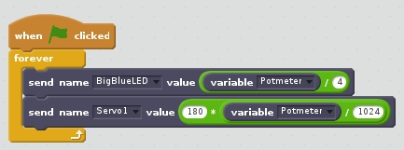
Testing the servo
Reconnect and repower the board
Update the loop where you set the Big Blue LED value dependent on the potmeter reading to now also set Servo 1.
But watch out: values have to be between 0 and 180.
To avoid overflow: first divide by 1024, then multiply by 180.
You may observe jitter.
Because the values of the potmeter will drift a bit and there will be power fluctuations, the reading of the potmeter will not be constant.
We will in the advanced workshop show how to deal with jitter

Slide 17
Controlling a buzzer with PWM
The buzzer will sound if it gets a signal in an audible frequency range.
A PWM signal on Arduino gives ca. 800 Hz.
Different for different pins
You will see that there is not much influence by changing the duty cycle.

Slide 18
Connect the buzzer to pin 11
Carefully watch the wires. Connect Vcc, GND and I/O correctly!
to pin 5
Don’t forget: 9V and USB cable out before making changes!

Slide 19
Testing the buzzer
No need to restart scratchClient, because the config file was not changed.
Add the setting of the buzzer to the loop where you already set the servo and the Big Blue LED.
Like with the LED, the values must be between 0 and 255.
Only test a short time (to save the ears of your neighbors ☺).

Slide 20
PWM limitations of Arduino (Nano and Uno)
General PWM is available on pins 3, 5, 6, 9, 10, 11
Servo can be configured on those pins, but also on 2, 4, 7, 8, 12
If a servo is configured on any pin, pins 9 and 10 cannot be configured as PWM anymore.
The config tool will warn you if you do it wrongly.

Slide 21
Part 3: Summary & take aways

Slide 22
Takeaways of the beginners and intermediate workshops
With scratchClient you define:
Function of each pin
Symbolic name for each configured pin
scratchClient config is the tool to setup the configuration
Restart scratchClient after you changed the configuration
Put a resistor in series with LEDs
Put a resistor in series with switches
Configure a pull up resistor if the input signal goes between 0 Volt and being open rather than between 0 Volt and 3 to 5 Volt.
In Scratch 2, you use the extension block for scratchClient to get blocks that you can use to interact with scratchClient
You can monitor the value of all pins from the browser
scratchClient can do much more…
There are some anomalies, therefore
Save the Scratch 2 files in the home folder (as Scratch 2 proposes)
Run CleanUpScratchFiles.sh on the desktop (once after start up of the RPi)
Use the files on the desktop
Functions that a pin on Arduino can have:
Digital In
Digital Out
Analog In
No Analog Out
Pulse Width Modulation as alternative for Analog Out
For modulating the brightness of a LED
For controlling a servo
For controlling a buzzer
There a few more, see the advanced workshop
You can configure pull up resistors on Digital In

Slide 23
End of the intermediate workshop

